Slide 1

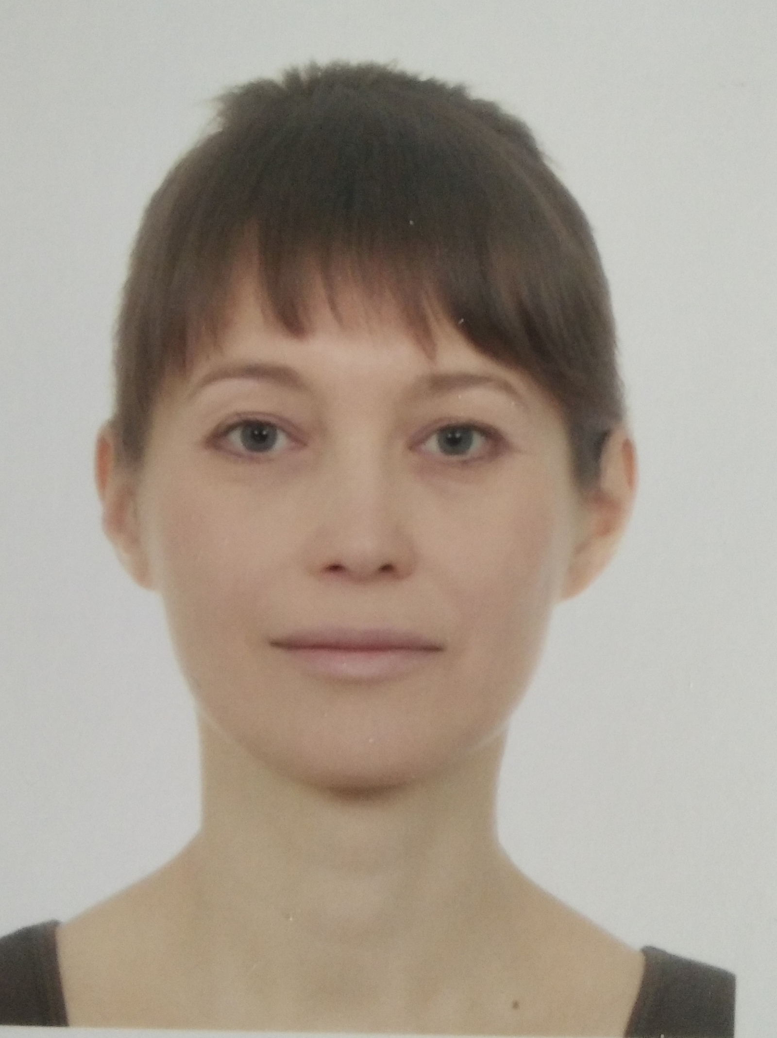





Elena
Kazantseva
Specialization
Education
SQL, Data Bases, DWH, ETL
UYGU
It experience
Knowledge of language
10+ years
Russian – native
English – B2
Spanish – A1
SQL - Developer, Analyst
https://github.com/ElenaKaza
svechikrd@gmail.com
+7 (909) 461 02 02
Skills and experience
Projects
Technical: SQL, PostgreSQL, MySQL, Teradata, Oracle, MongoDB (beginner), SharePoint, Html, xml, Json, Windows, Linux (beginner), Hadoop, hdfs, Hive (beginner), Python (learning)
Functional: Jira, Confluence, GIT, GitHub, Miro
Industry: Data Marts for Banks, Inventory Control, Enterprise management automation, Electronic document management
Accenture - Application Development Analyst + SQL- developer. 08.2021 – 04.2022
Development of a data marts for the Banks (Enterprise Risk Management + Management Reporting on Profit & Losses):
Integration of data sources and storage;
Creation and modification of data flows, data processing procedures, storage architecture;
Data mapping, clearing, enrichment, unification; Functional testing.
Technology: Teradata, PostgreSQL, Jira, Confluence
Self-employment - Software implementation specialist. 02.2020 - 08.2021
Implementation of electronic document management of engineering data in the field of construction
Research of organization, interviews of employees; Creating of TOR;
Customization of software for the needs of the organization;
Implementation of an electronic document management system;
Preparation of technical documentation and user manuals;
User training, setting rights and roles; Technical support.
Technology: SharePoint
VAZSYSTEM - SQL & Frontend developer. 05.1999 - 10.2011
Development of the Enterprise Management System:
Full development of warehouse accounting (posting of goods to the warehouse, placement in the storage system, issuance, maintenance of warehouse and accounting documents, reporting.
Technology: Oracle, Delphi, Clarion
PromInform - Data base & Frontend developer. 09.1994 - 08.1998
Development of automated settlement system in the field of communications:
Development of the Subscribers Data Bases; Development of the checks
Technology: Clarion
Certificates
OTUS, Data Bases – 2021
Personality
I am open, positive, friendly, creative, hardworking, accurate. Like to study. Have a good time management skills and high level of responsibility. Love SQL.

